Slide 1
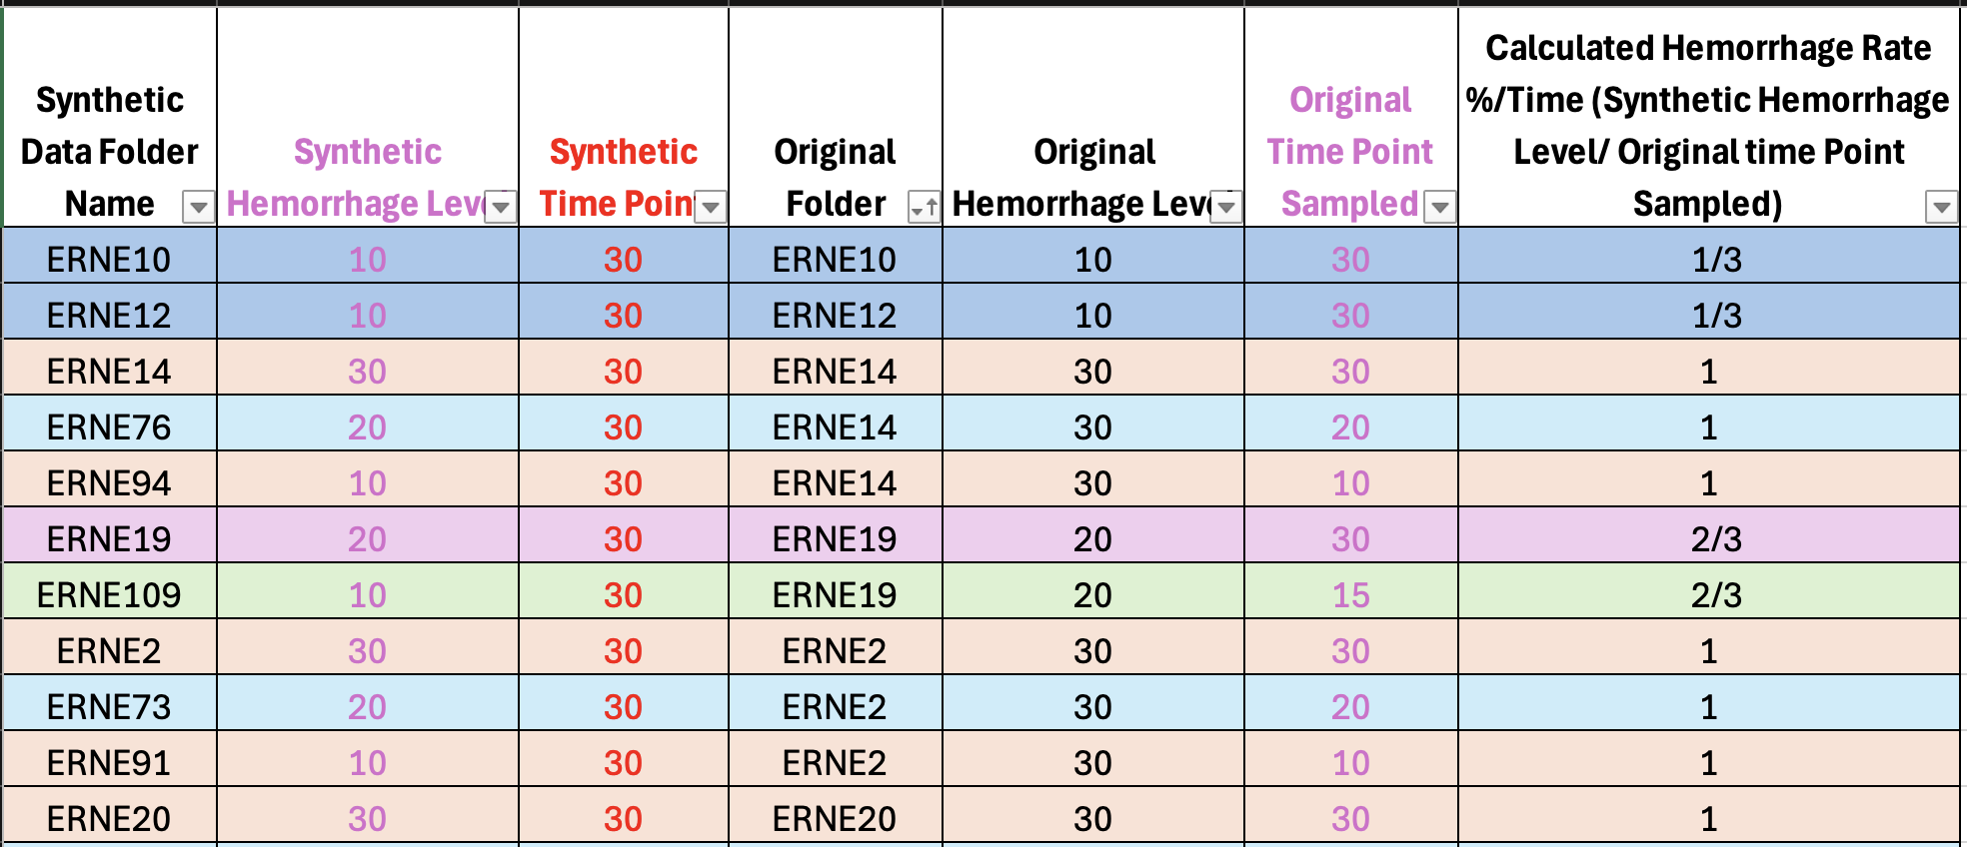
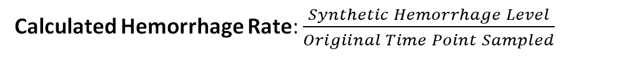
Synthetic Hemorrhage Level: Target hemorrhage level in the synthetic data (e.g., 10, 20, 30).
Original Hemorrhage Level: The starting hemorrhage level (20% or 30%).
Original Time Point Sampled: When the original sample was taken (e.g time = 10,15,20 or 30).
Synthetic Time Point: The time when the synthetic version of that data was taken (time=30).
Calculated Hemorrhage Rate: $\frac{Synthetic Hemorrhage Level}{Origiinal Time Point Sampled}$

Slide 2
Cardiac Output

Slide 3
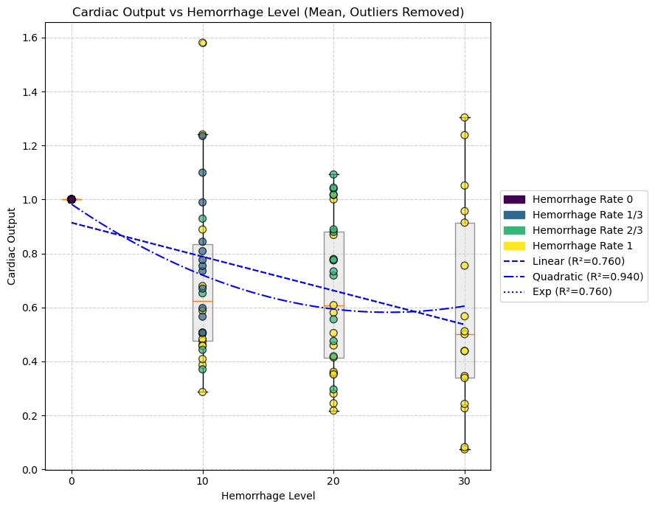
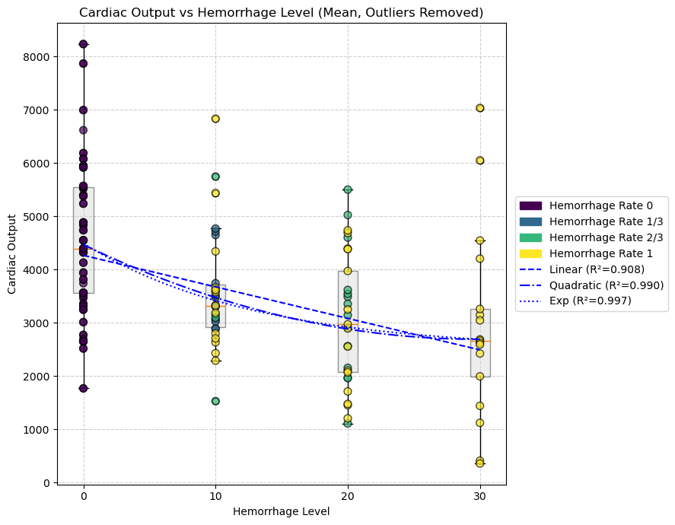
Hemorrhage Level
--- Cardiac Output (Mean) ---
Linear: y = -59.1807x + 4267.8416 R² = 0.9077
Quadratic: y = 1.9967x² + -119.0821x + 4467.5130 R² = 0.9903
Exp: y = 1999.5892 * exp(-0.0771x) + 2492.2911 R² = 0.9974
--- Cardiac Output (Mean) ---
Linear: y = -0.0126x + 0.9139 R² = 0.7604
Quadratic: y = 0.0007x² + -0.0331x + 0.9824 R² = 0.9404
Exp: y = -1040.0387 * exp(0.0000x) + 1040.9526 R² = 0.7603

Slide 4
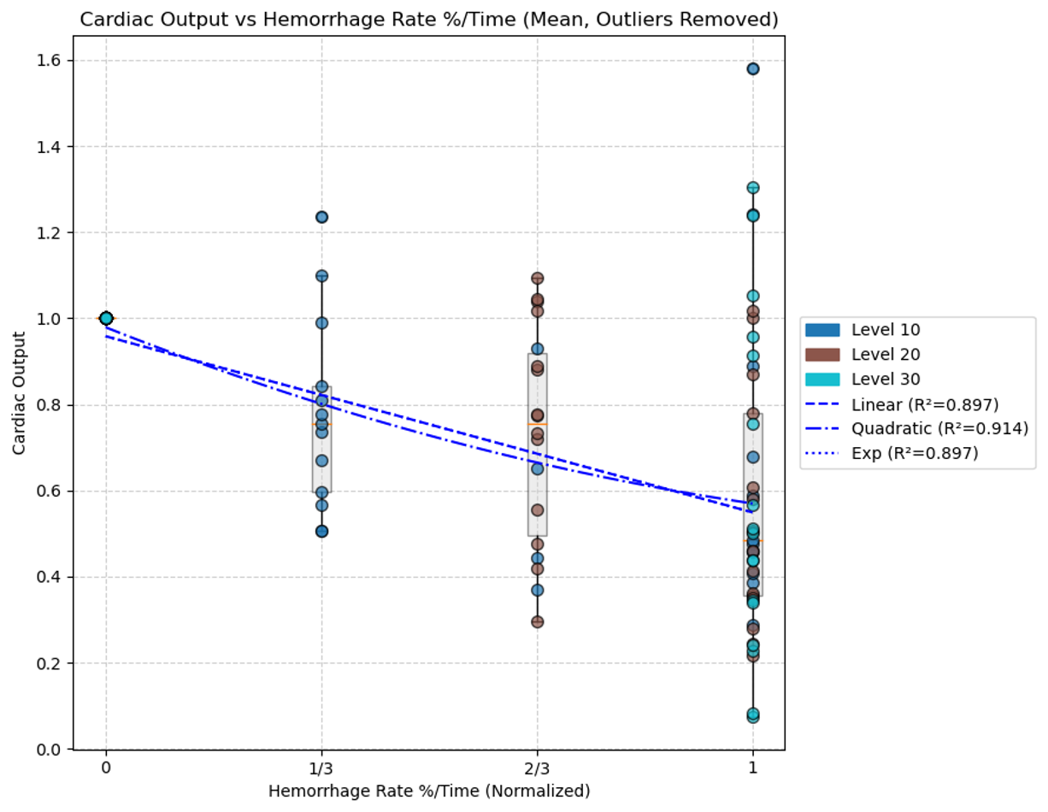
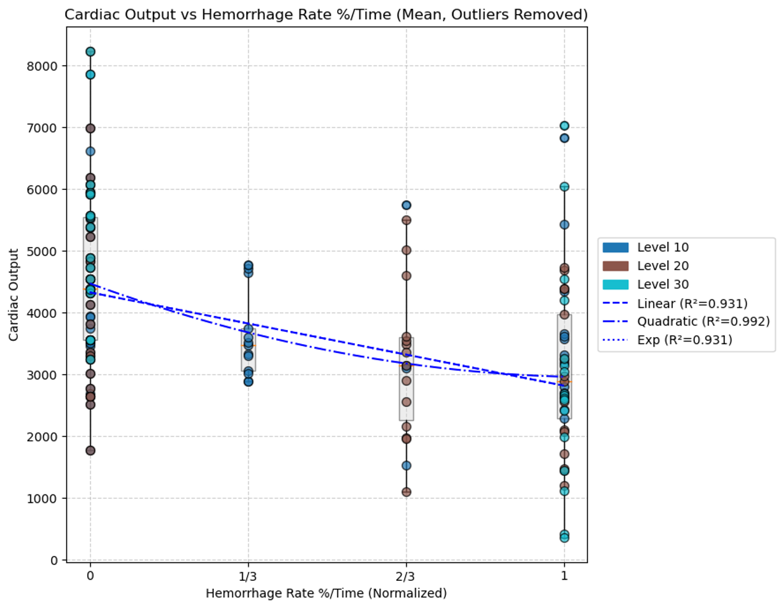
Hemorrhage Rate
--- Cardiac Output (Mean) ---
Linear: y = -1510.2087x + 4330.6314 R² = 0.9309
Quadratic: y = 1297.7196x² + -2807.9283x + 4474.8225 R² = 0.9921
Exp: y = -4540184.0737 * exp(0.0003x) + 4544514.6523 R² = 0.9309
--- Cardiac Output (Mean) ---
Linear: y = -0.4093x + 0.9582 R² = 0.8972
Quadratic: y = 0.1861x² + -0.5953x + 0.9788 R² = 0.9137
Exp: y = -846.3047 * exp(0.0005x) + 847.2628 R² = 0.8972

Slide 5
Heart Rate

Slide 6
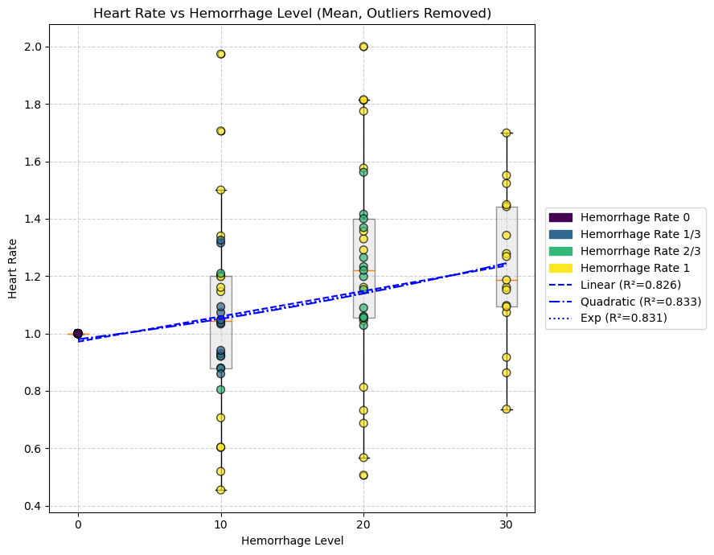
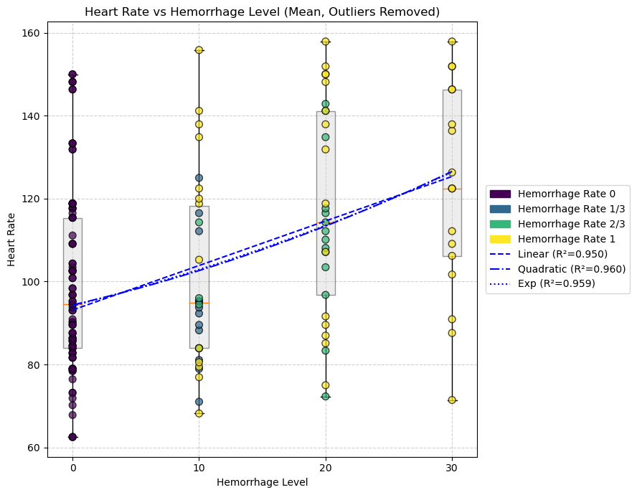
Hemorrhage Level
--- Heart Rate (Mean) ---
Linear: y = 0.0088x + 0.9713 R² = 0.8260
Quadratic: y = 0.0001x² + 0.0062x + 0.9801 R² = 0.8326
Exp: y = 0.5182 * exp(0.0138x) + 0.4589 R² = 0.8305
--- Heart Rate (Mean) ---
Linear: y = 1.0739x + 93.1284 R² = 0.9504
Quadratic: y = 0.0122x² + 0.7071x + 94.3510 R² = 0.9602
Exp: y = 42.2719 * exp(0.0189x) + 51.8370 R² = 0.9585

Slide 7
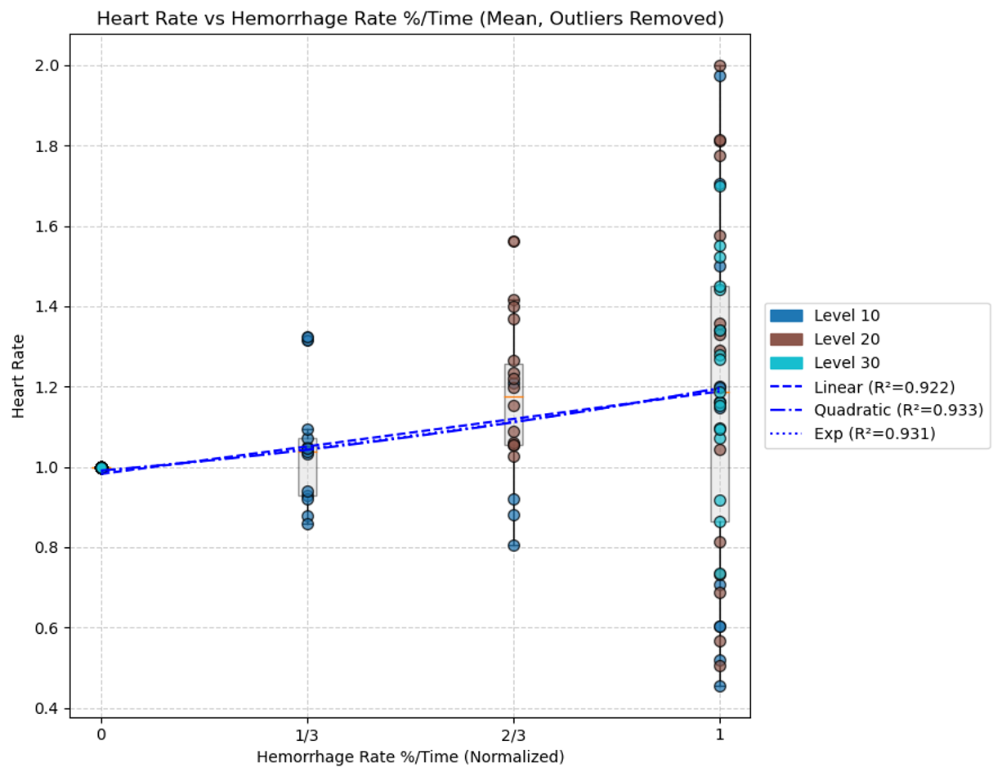
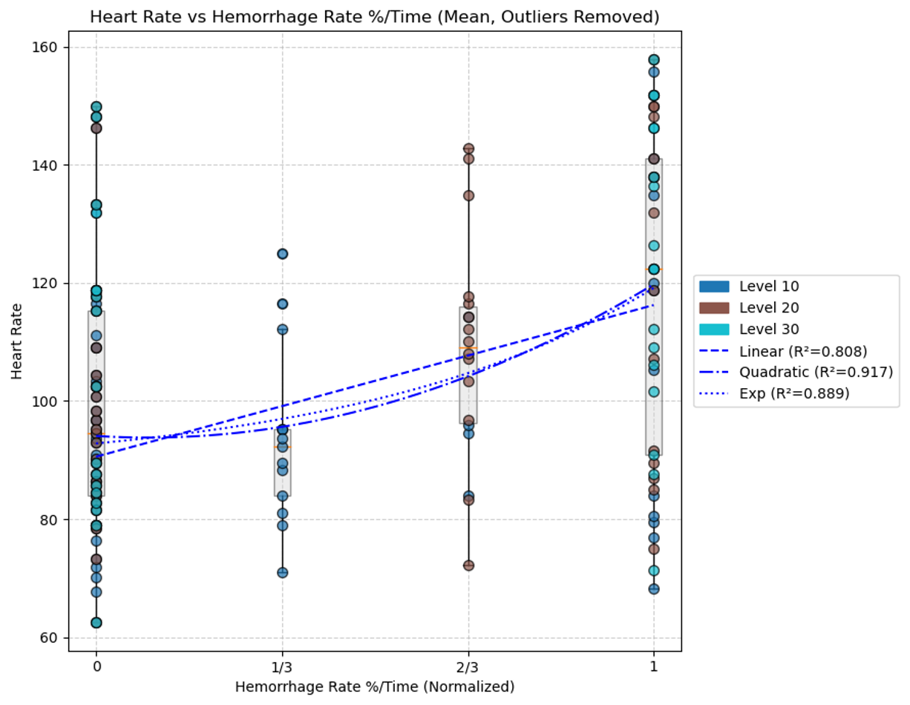
Hemorrhage Rate
--- Heart Rate (Mean) ---
Linear: y = 0.2054x + 0.9824 R² = 0.9220
Quadratic: y = 0.0755x² + 0.1299x + 0.9908 R² = 0.9330
Exp: y = 0.2624 * exp(0.5792x) + 0.7264 R² = 0.9307
--- Heart Rate (Mean) ---
Linear: y = 25.6832x + 90.5648 R² = 0.8080
Quadratic: y = 31.6031x² + -5.9199x + 94.0763 R² = 0.9168 Exp: y = 4.8029 * exp(1.8692x) + 88.0079 R² = 0.8890

Slide 8
Ejection Fraction

Slide 9
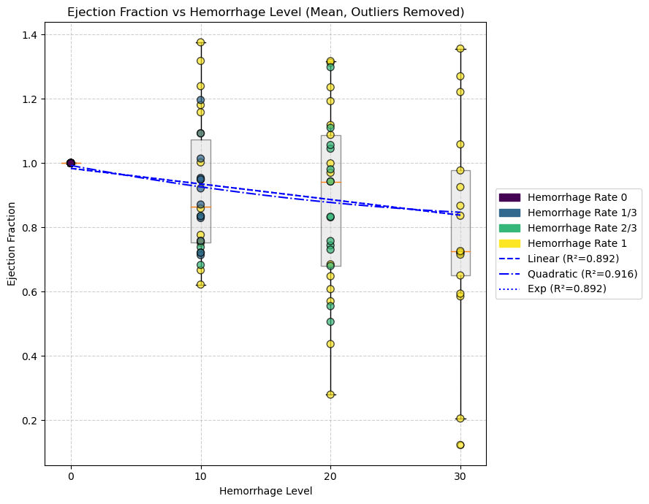
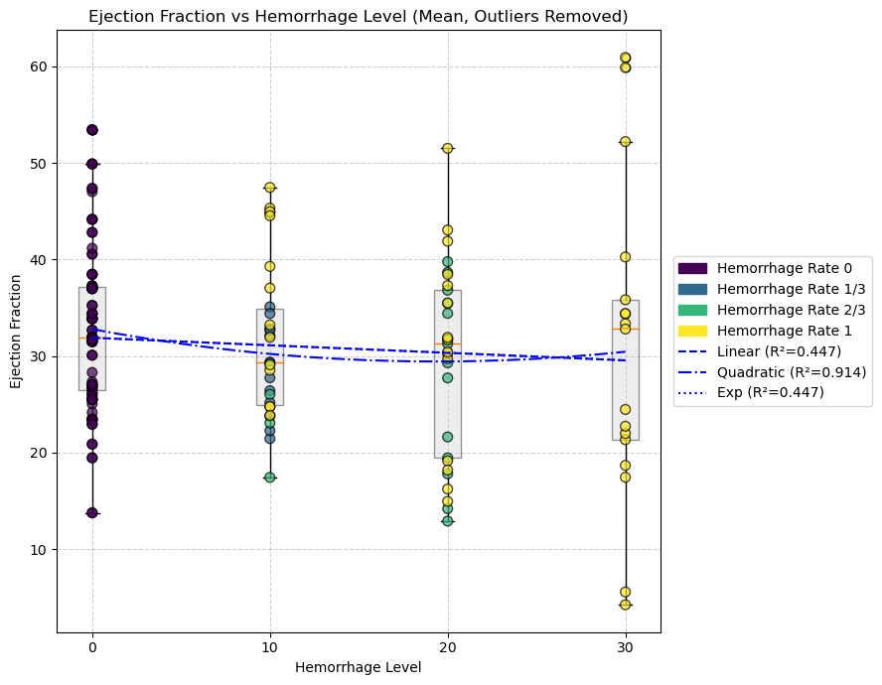
Hemorrhage Level
--- Ejection Fraction (Mean) ---
Linear: y = -0.0049x + 0.9835 R² = 0.8916
Quadratic: y = 0.0001x² + -0.0076x + 0.9926 R² = 0.9162
Exp: y = -426.3210 * exp(0.0000x) + 427.3045 R² = 0.8916
--- Ejection Fraction (Mean) ---
Linear: y = -0.0782x + 31.8900 R² = 0.4467
Quadratic: y = 0.0089x² + -0.3464x + 32.7842 R² = 0.9145
Exp: y = -8396.3286 * exp(0.0000x) + 8428.2185 R² = 0.4467

Slide 10
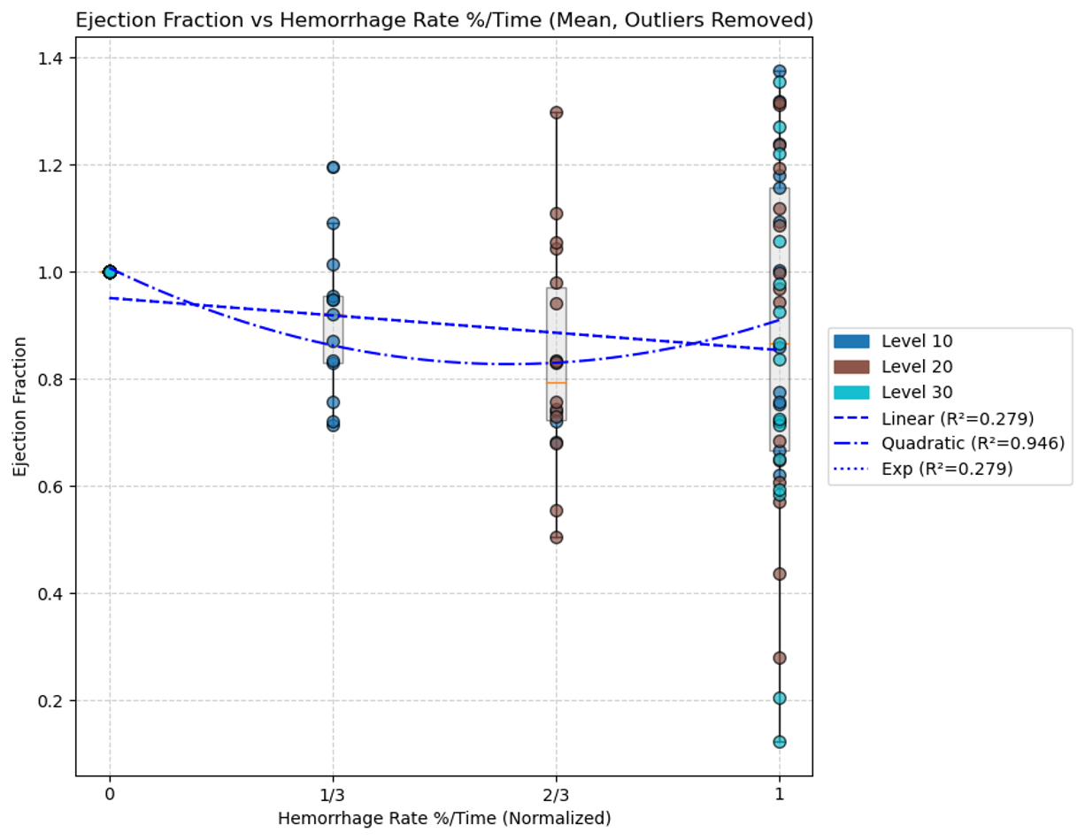
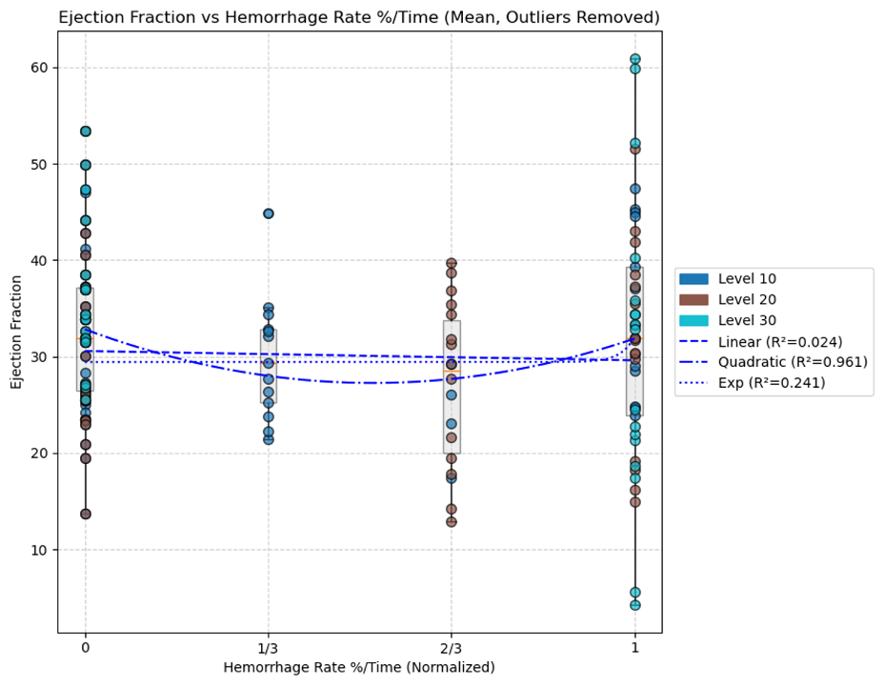
Hemorrhage Rate
--- Ejection Fraction (Mean) ---
Linear: y = -0.0973x + 0.9511 R² = 0.2789
Quadratic: y = 0.5046x² + -0.6019x + 1.0071 R² = 0.9462
Exp: y = -291.9339 * exp(0.0003x) + 292.8849 R² = 0.2788
--- Ejection Fraction (Mean) ---
Linear: y = -0.9613x + 30.5630 R² = 0.0236
Quadratic: y = 20.3066x² + -21.2679x + 32.8193 R² = 0.9609
Exp: y = 0.0000 * exp(40.8740x) + 29.4218 R² = 0.2410

Slide 11
Stroke Work

Slide 12
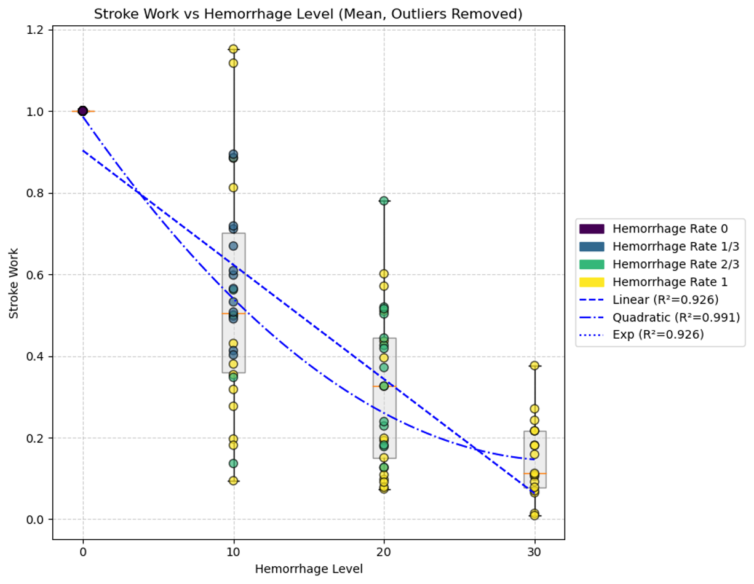
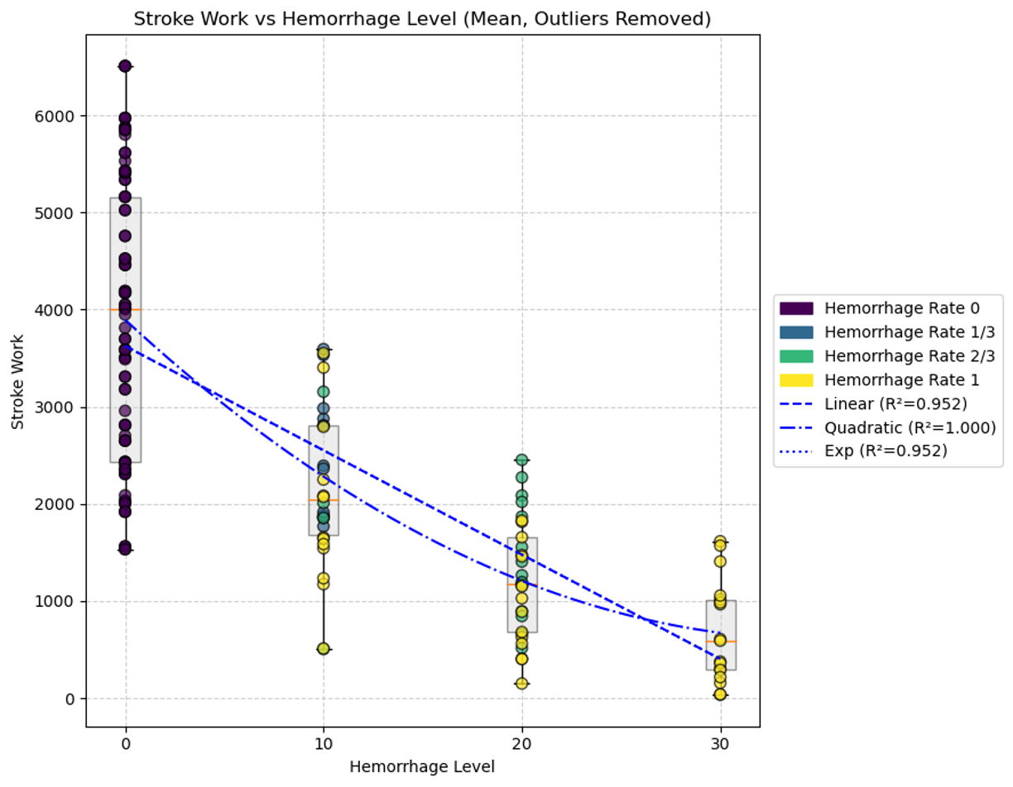
Hemorrhage Level
(mL)
--- Stroke Work (Mean) ---
Linear: y = -107.4172x + 3625.8559 R² = 0.9517
Quadratic: y = 2.6978x² + -188.3497x + 3895.6310 R² = 0.9997
Exp: y = -8709691.0776 * exp(0.0000x) + 8713316.8290 R² = 0.9517
--- Stroke Work (Mean) ---
Linear: y = -0.0280x + 0.9031 R² = 0.9258
Quadratic: y = 0.0008x² + -0.0529x + 0.9863 R² = 0.9911
Exp: y = -2934.0782 * exp(0.0000x) + 2934.9814 R² = 0.9258

Slide 13
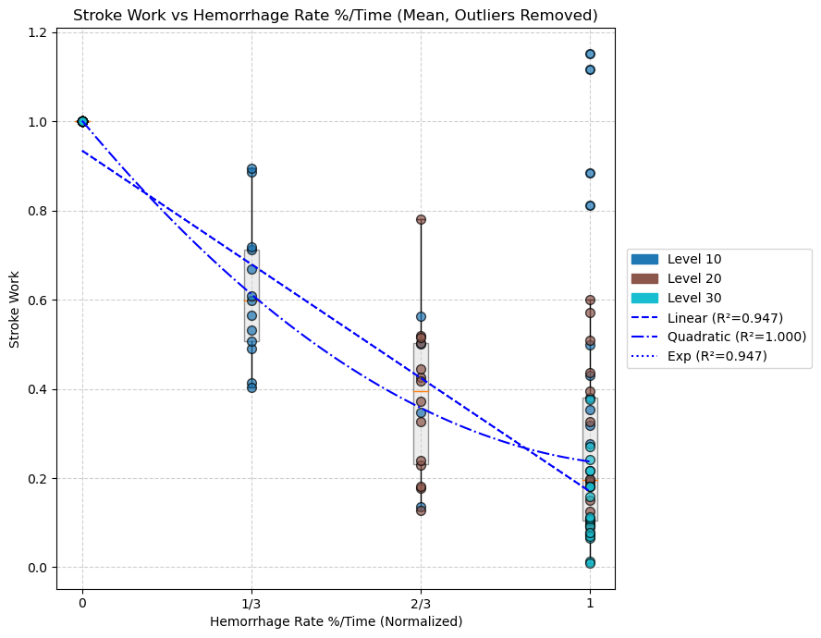
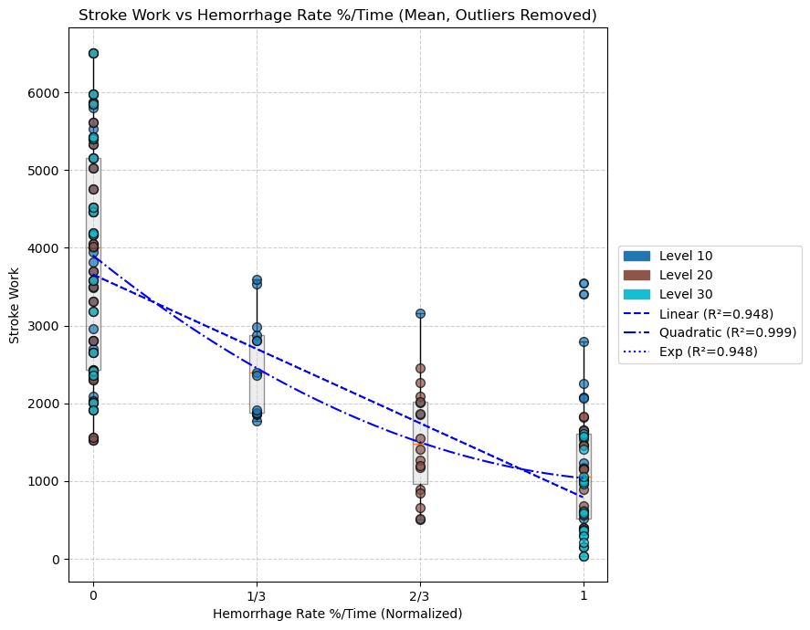
Hemorrhage Rate
(mL)
--- Stroke Work (Mean) ---
Linear: y = -2866.4032x + 3658.3721 R² = 0.9482
Quadratic: y = 2217.8420x² + -5084.2452x + 3904.7990 R² = 0.9986
Exp: y = -8546018.3813 * exp(0.0003x) + 8549676.6792 R² = 0.9481
--- Stroke Work (Mean) ---
Linear: y = -0.7640x + 0.9339 R² = 0.9473
Quadratic: y = 0.6041x² + -1.3682x + 1.0010 R² = 0.9999
Exp: y = -2638.0521 * exp(0.0003x) + 2638.9860 R² = 0.9473

Slide 14
Stroke Volume

Slide 15
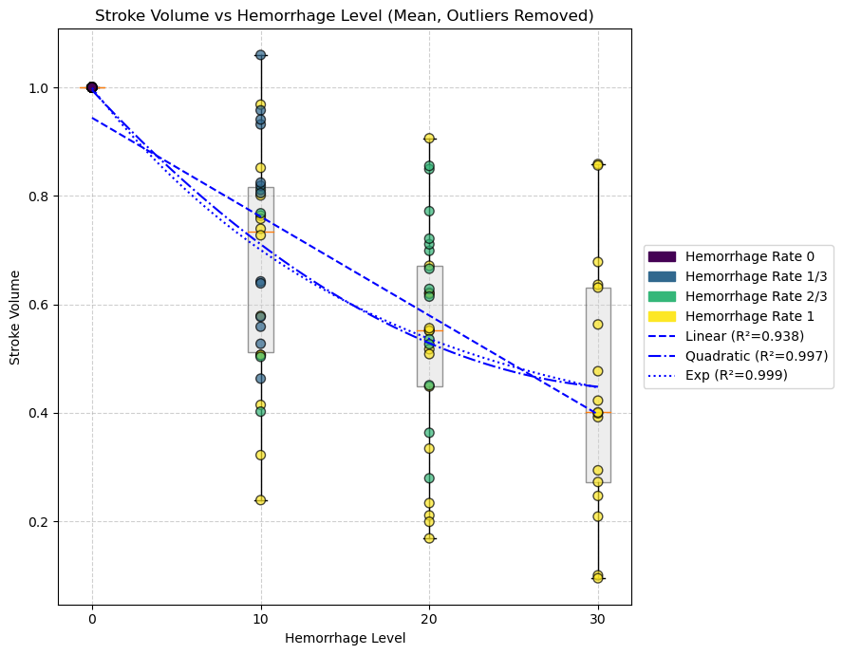
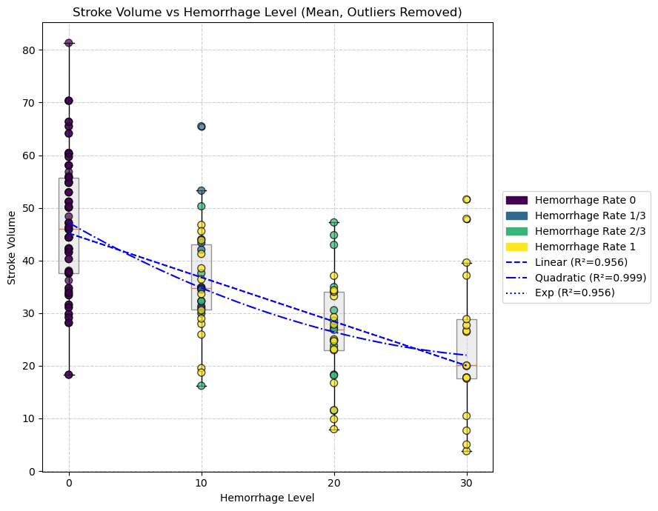
Hemorrhage Level
--- Stroke Volume (Mean) ---
Linear: y = -0.8387x + 45.1778 R² = 0.9558
Quadratic: y = 0.0200x² + -1.4380x + 47.1756 R² = 0.9991
Exp: y = -67887.0717 * exp(0.0000x) + 67932.2487 R² = 0.9557
--- Stroke Volume (Mean) ---
Linear: y = -0.0182x + 0.9439 R² = 0.9384
Quadratic: y = 0.0005x² + -0.0335x + 0.9949 R² = 0.9971
Exp: y = 0.6617 * exp(-0.0600x) + 0.3373 R² = 0.9995

Slide 16
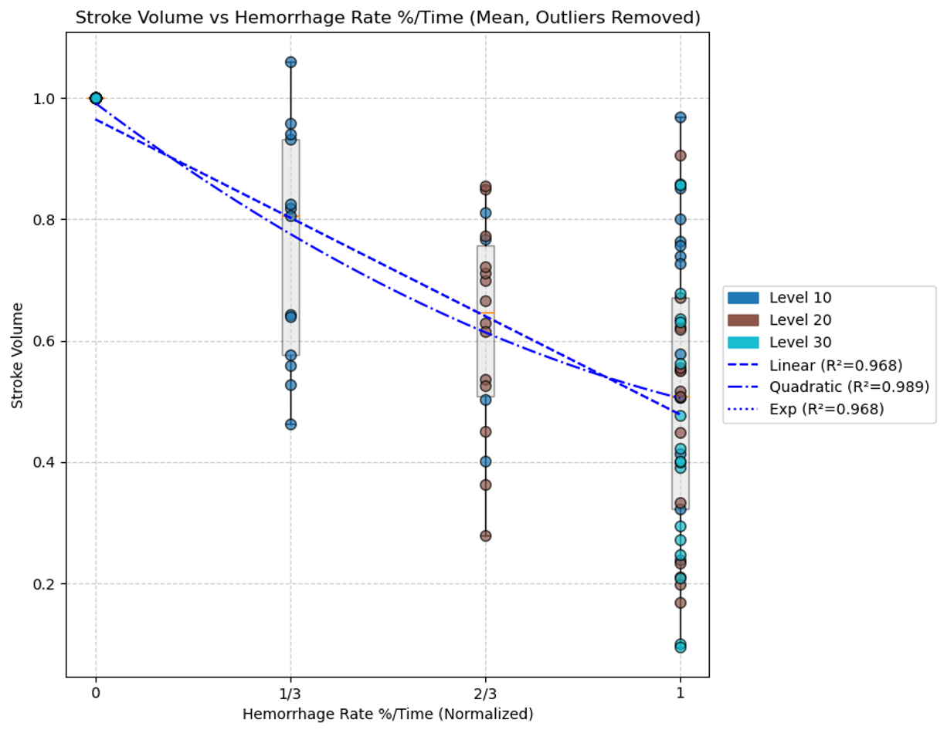
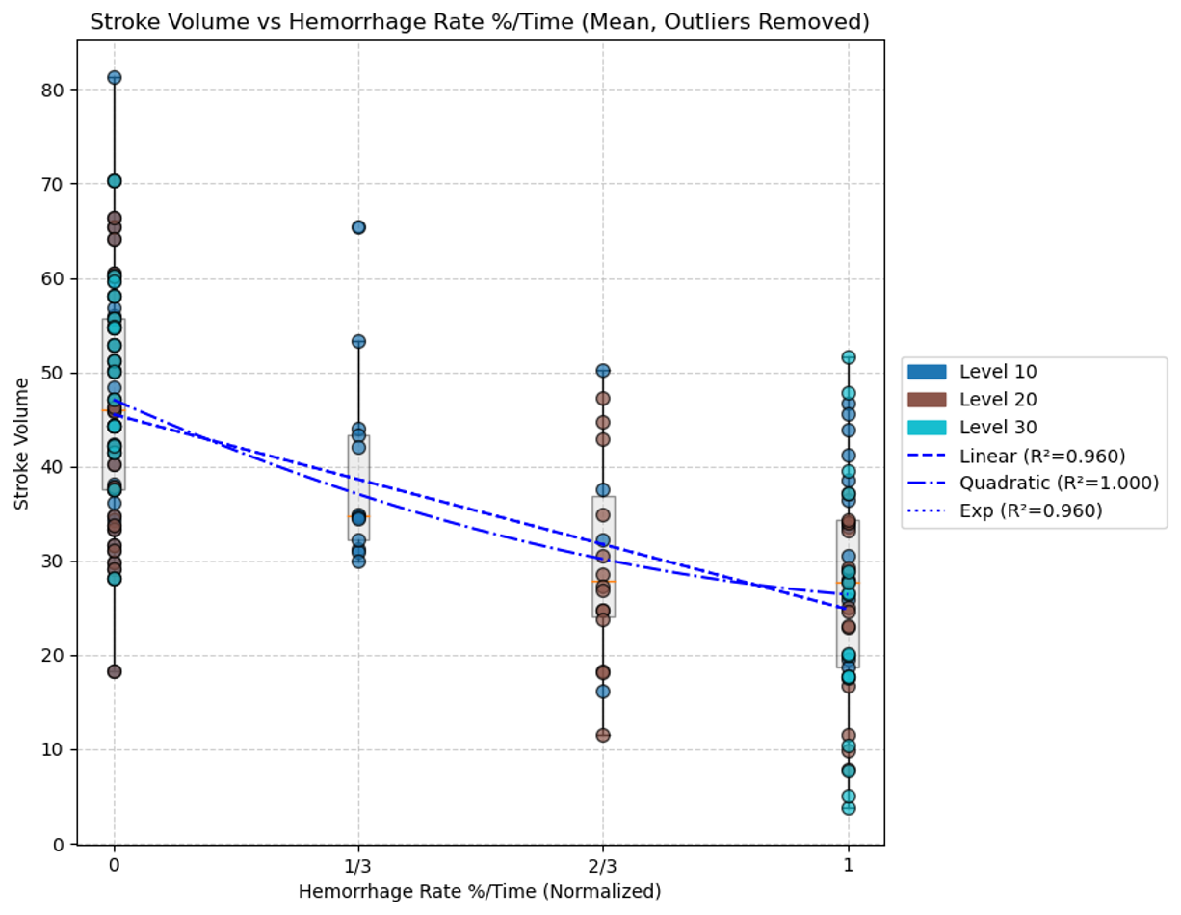
Hemorrhage Rate
--- Stroke Volume (Mean) ---
Linear: y = -20.6825x + 45.5158 R² = 0.9600
Quadratic: y = 14.1465x² + -34.8290x + 47.0876 R² = 0.9999
Exp: y = -69763.7218 * exp(0.0003x) + 69809.2371 R² = 0.9600
--- Stroke Volume (Mean) ---
Linear: y = -0.4863x + 0.9646 R² = 0.9678
Quadratic: y = 0.2405x² + -0.7267x + 0.9913 R² = 0.9888
Exp: y = -1459.8879 * exp(0.0003x) + 1460.8525 R² = 0.9678

Slide 17
GitHub Page?
https://github.com/falmohandis/AI-and-Advanced-Modeling-Techniques-for-Optimizing-Resuscitation-Strategies-in-Hemorrhagic-Shock

Slide 18
8-Isoprostane Samples Completed
 | 10% No (N = 6) | 20% No (N = 6) | 30% No (N = 6) | 10% Partial (N = 6) | 20% Partial (N = 6) | 30% Partial (N = 6) | 10% Full (N = 6) | 20% Full (N = 6) | 30% Full (N = 6)
Male | ERNE-23 ERNE-33 ERNE-61 | ERNE-34 ERNE-54 ERNE-72 | ERNE-31 ERNE-36 ERNE-52 | ERNE-25 ERNE-32 ERNE-62 | ERNE-47 ERNE-53 ERNE-71 | ERNE-35 ERNE-55 ERNE-64 | ERNE-10 ERNE-44 ERNE-70 | ERNE-45 ERNE-56 ERNE-63 | ERNE-02 ERNE-26 ERNE-65
Female | ERNE-40 ERNE-48 ERNE-67 | ERNE-30 ERNE-50 ERNE-60 | ERNE-05 ERNE-29 ERNE-66 | ERNE-27 ERNE-39 ERNE-58 | ERNE-21 ERNE-49 ERNE-51 | ERNE-20 ERNE-43 ERNE-68 | ERNE-12 ERNE-38 ERNE-59 | ERNE-19 ERNE-41 ERNE-69 | ERNE-07 ERNE-14 ERNE-57

